Slide 1
Nonprofit Open Data Collective
International Society for Third-Sector Research
Jesse Lecy Nathan Grasse July 11, 2018

Slide 2
History of the form 990
1941
First required in 1941 as a two-page form disclosing major donors
Revisions and Evolution
Revised in 1947, 1976, 2000, 2007, & 2012
Now
includes revenues, expenditures, corporate governance, key employees, grants, political activities, and much more.
2010: Electronic Filing

Slide 3
Form 990
Part I - Summary
Part II - Signature Block
Part III - Statement of Program Service Accomplishments
Part IV - Checklist of Required Schedules
Part V - Statements Regarding Other IRS Filings and Tax Compliance
Part VI - Governance, Management, and Disclosure
Section A. Governing Body and Management
Section B. Policies
Section C. Disclosure
Part VII - Compensation of Officers, Directors, Trustees, Key Employees, Highest Compensated Employees, and Independent Contractors
Section A. Officers, Directors, Trustees, Key Employees, and Highest Compensated Employees
Section B. Independent Contractors
Part VIII - Statement of Revenue
Part IX - Statement of Functional Expenses
Part X - Balance Sheet
Part XI - Reconciliation of Net Assets
Part XII - Financial Statements and Reporting

Slide 4
schedules
Schedule A | Public Charity Status and Public Support
Schedule B | Schedule of Contributors
Schedule C | Political Campaign and Lobbying Activities
Schedule D | Supplemental Financial Statements
Schedule E | Schools
Schedule F | Statement of Activities Outside the United States
Schedule G | Supplemental Information Regarding Fundraising or Gaming Activities
Schedule H | Hospitals
Schedule I | Grants and Other Assistance to Organizations, Governments, and Individuals in the US
Schedule J | Compensation Information
Schedule K | Supplemental Information on Tax-Exempt Bonds
Schedule L | Transactions With Interested Persons
Schedule M | Noncash Contributions
Schedule N | Liquidation, Termination, Dissolution, or Significant Disposition of Assets
Schedule O | Supplemental Information to Form 990
Schedule R | Related Organizations and Unrelated Partnerships

Slide 5
Form 990
Nonprofits can file three versions:
Form 990
Form 990-EZ
Revenues less than $200,000 and assets less than $500,000
Form 990-N (e-Postcard)
Revenues less than $50,000
Foundations: 990-PF
Churches – optional

Slide 6
Use of 990 Data for Scholarship
National Center for Charitable Statistics was established in 1982
Joined the Center for Nonprofits and Philanthropy at the Urban Institute in 1996
In a partnership with the IRS, they receive raw data files and have created the Core and Core Trend data files covering 1989 to 2015
Limited to financial variables, augmented with NTEE codes and geographic variables

Slide 7
The IRS 990 E-Filer Data
2010: The IRS began accepting electronic 990 submissions
2015: Lawsuit regarding FOIA Requests
2016: E-file data was released in as XML files on AWS

Slide 8
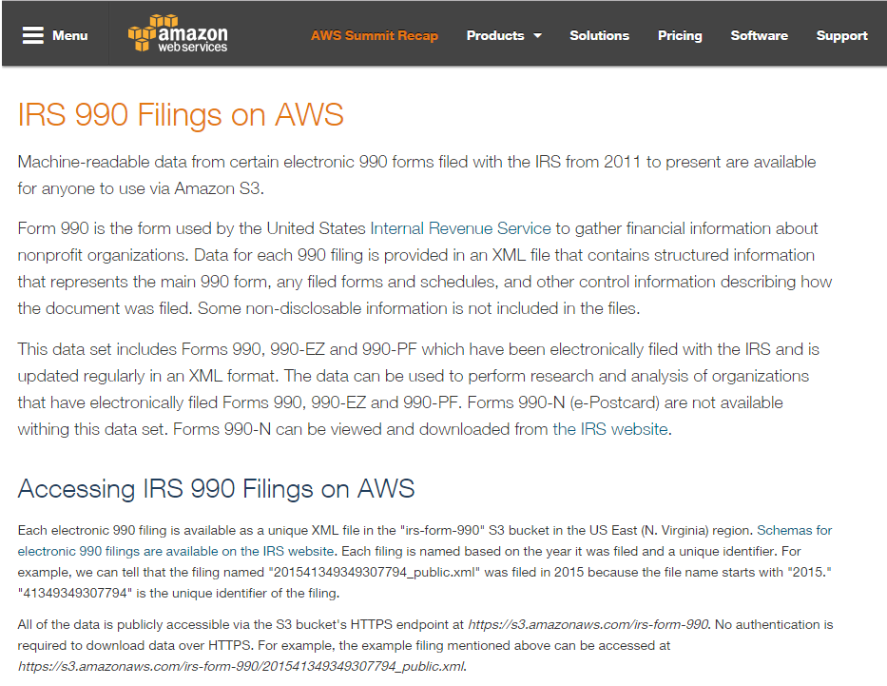
The IRS 990 E-Filer Data

Slide 9
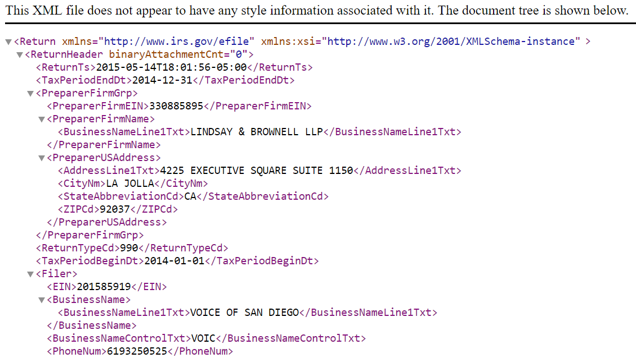
XML Documents

Slide 10
academics, aspen institute, charity navigator, guidestar, chronicle of philanthropy, pro publica

Slide 11
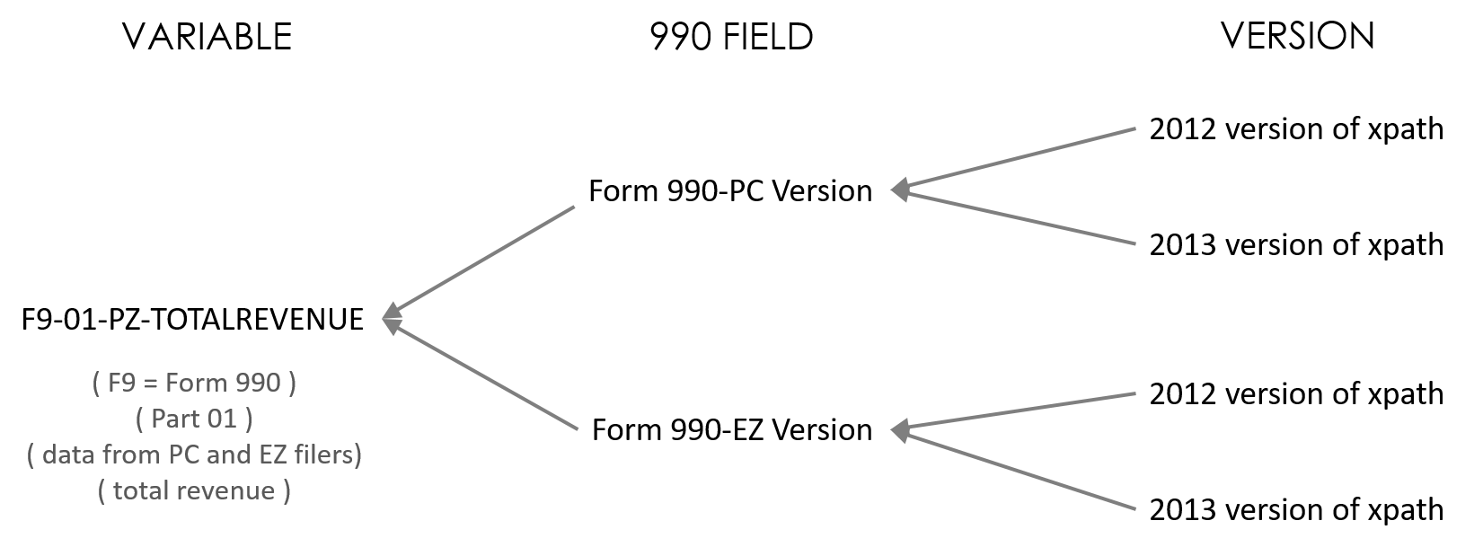
Master Concordance File: Grouping Xpaths by a Common Variable

Slide 12
Concordance Organization
Repeated as many times as there are xpaths for a specific variable
All unique instances
Reference the 2016 form version only

Slide 13
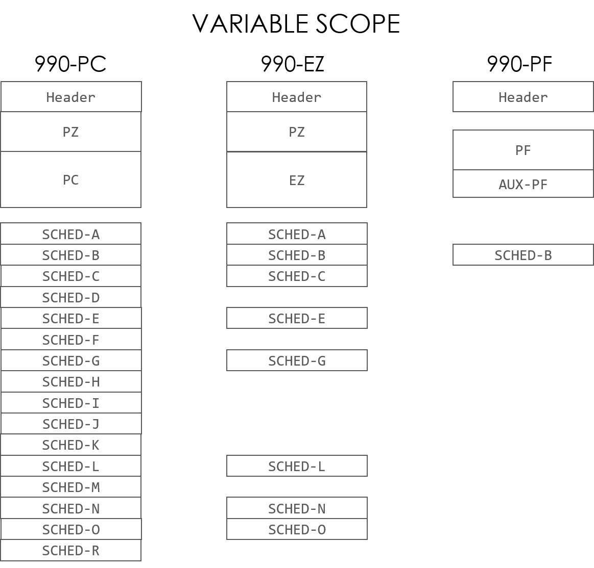
PZ Scope
SCOPE CODES HD = Header (all filers)
PZ = 990 + 990-EZ Filers
PC = Only 990 Filers
EZ = Only 990-EZ Filers
PF = Only 990-PF Filers
PC Scope

Slide 14
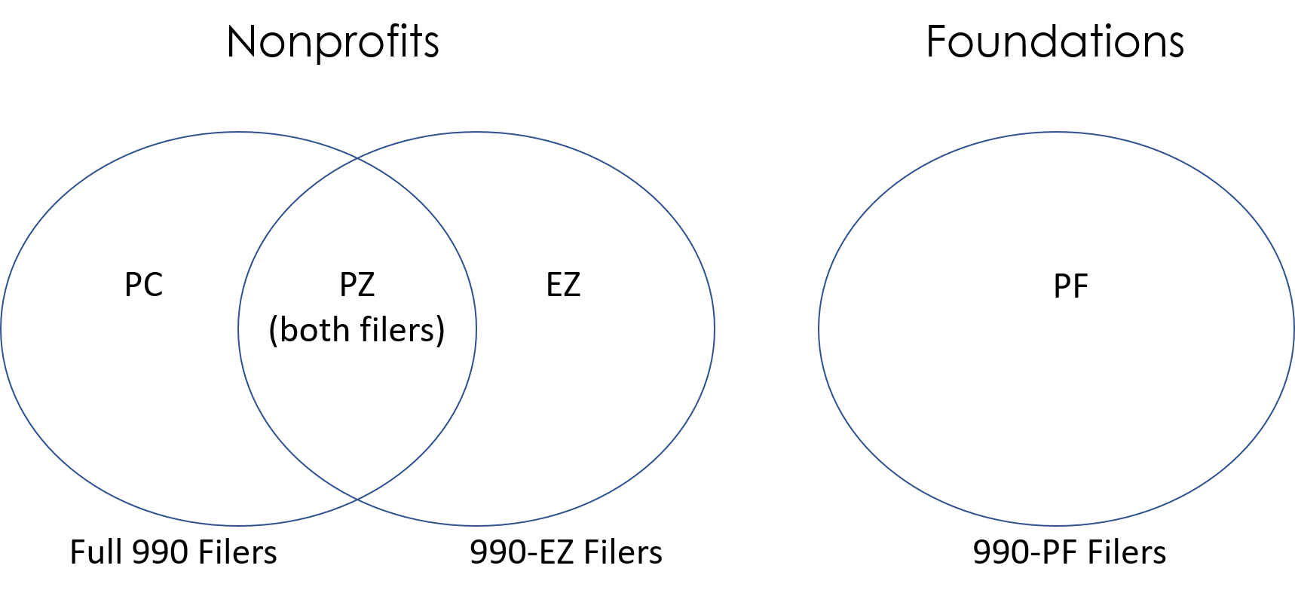
SCOPE – Variable Consistency Across Three 990 Forms
( Header fields are the same across all forms )

Slide 15
XPATHs
“Path” (address in XML doc)
Variable Name
"//Return/ReturnData/IRS990/CYProgramServiceRevenueAmt
Data in XML File

Slide 16
EXAMPLE USE: Current Year Program Service Revenue
## COPY AND PASTE XPATHS FROM IRS SPREADSHEET
V_990CPSRpost2013 <- "//Return/ReturnData/IRS990/CYProgramServiceRevenueAmt"
V_990CPSRpre2013 <- "//Return/ReturnData/IRS990/ProgramServiceRevenueCY"
V_990CPSR.EZpost2013 <- "//Return/ReturnData/IRS990EZ/ProgramServiceRevenueAmt"
V_990CPSR.EZpre2013 <- "//Return/ReturnData/IRS990EZ/ProgramServiceRevenue"
psr.current.xpath <- paste( V_990CPSRpost2013, V_990CPSRpre2013,
V_990CPSR.EZpost2013, V_990CPSR.EZpre2013, sep="|" )
## GRAB THE DATA FROM THE XML DOC
PSRCURRENT <- xml_text( xml_find_all( doc, psr.current.xpath ) )
## STANDARDIZE THE DATA THROUGH PRODUCTION RULES
PSRCURRENT <- changeMissingToZeros( PSRCURRENT )
4 Versions of the Same Variable:
PC and EZ; Pre and Post 2013 Changes

Slide 17
Data for one variable might be located at multiple “addresses” (xpaths)
The variable name includes information about the form and part of the variable, and what forms include that variable (the scope)

Slide 18
Opportunities

Slide 19
Potential Research Directions:
Taxonomies of nonprofit missions
Systematic study of program service accomplishments
Nonprofit mergers / joint ventures / dissolutions
Compensation studies: gender pay gap, pay for performance
Interlocking board studies
Governance and compliance

Slide 20
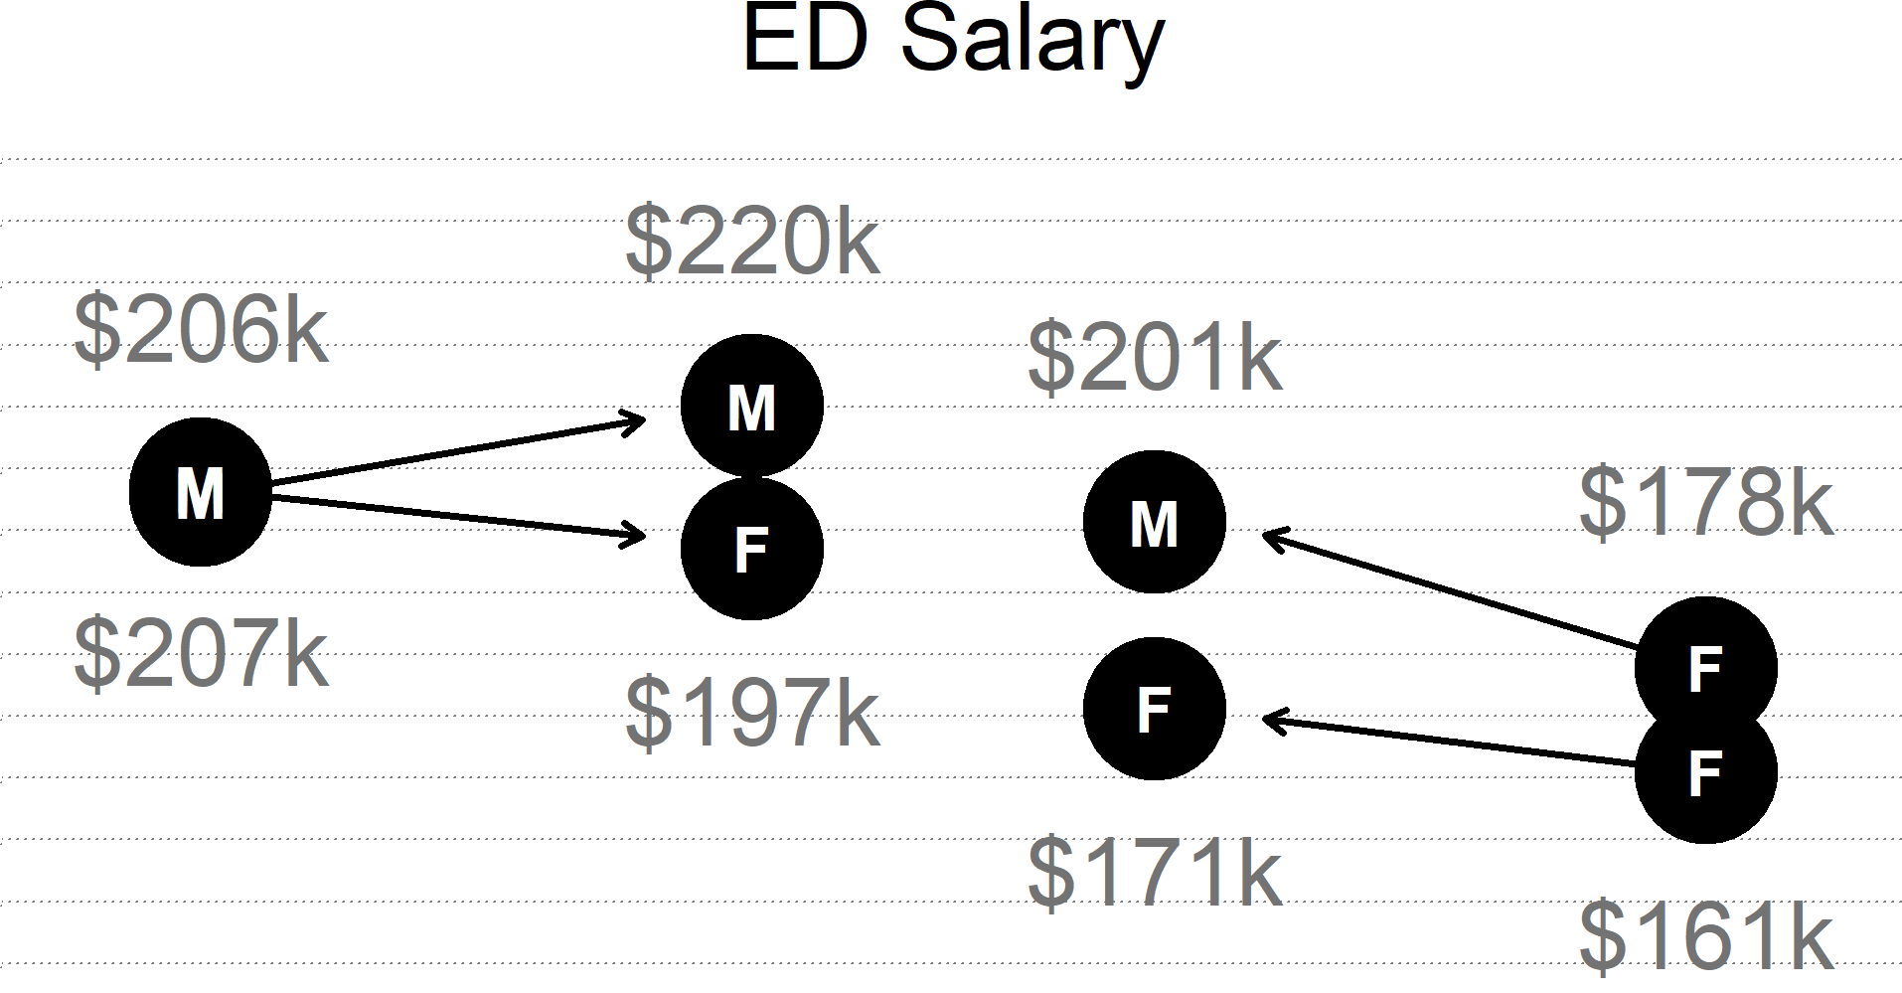

Slide 21
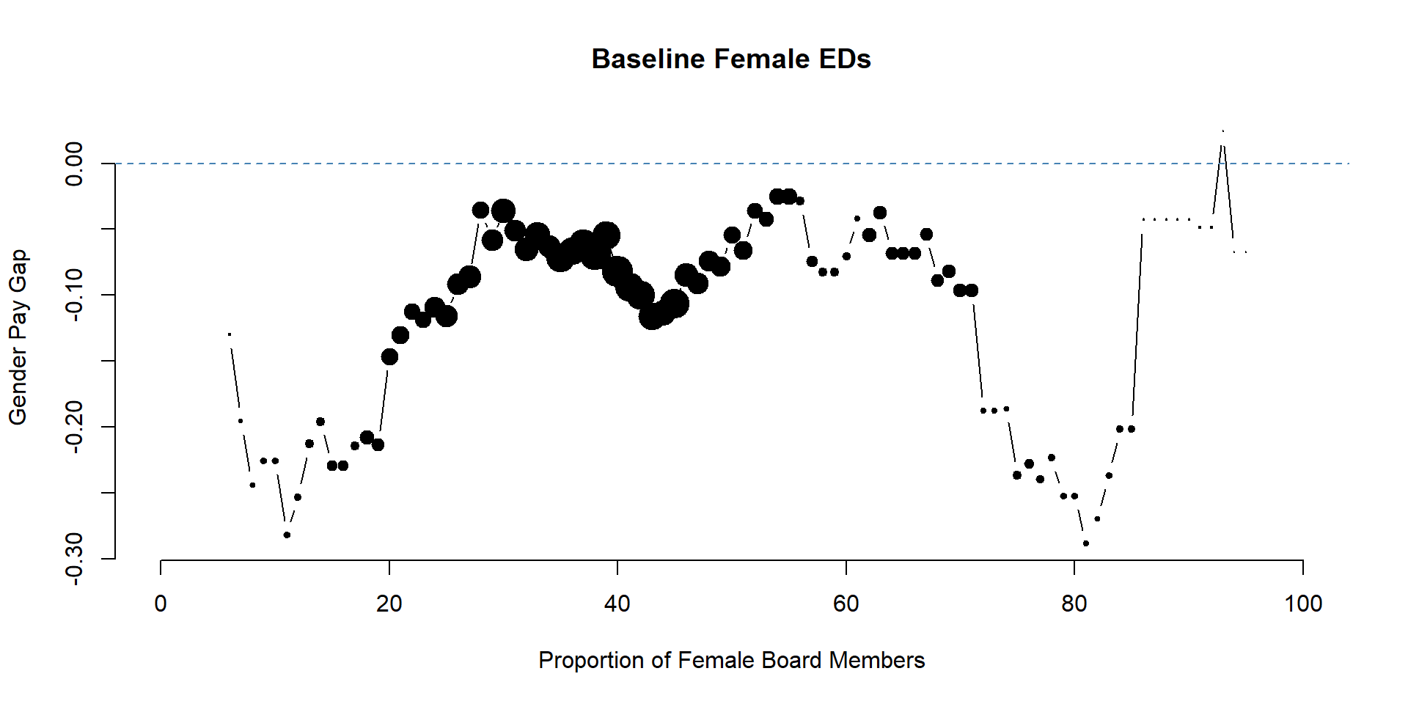

Slide 22
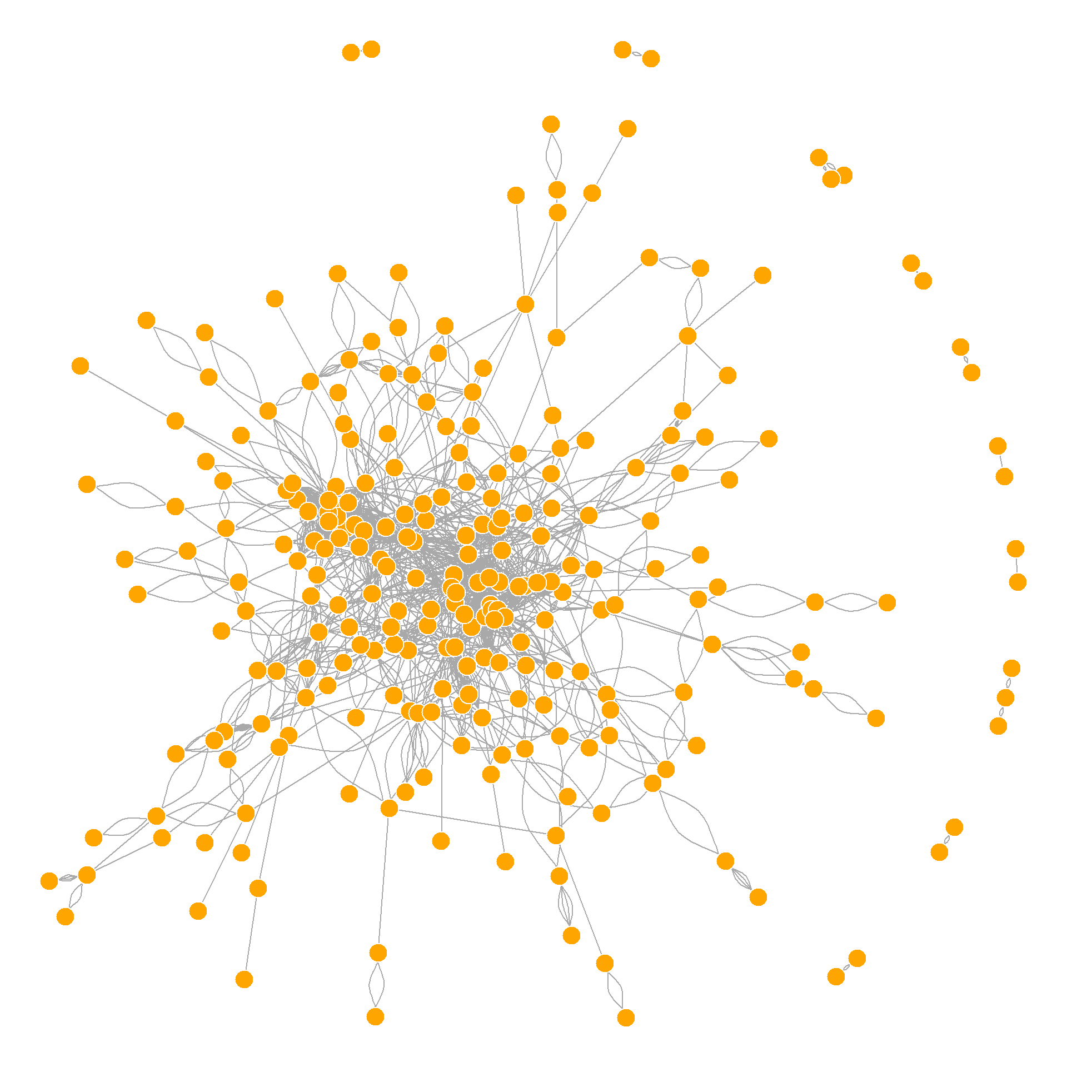

Slide 23
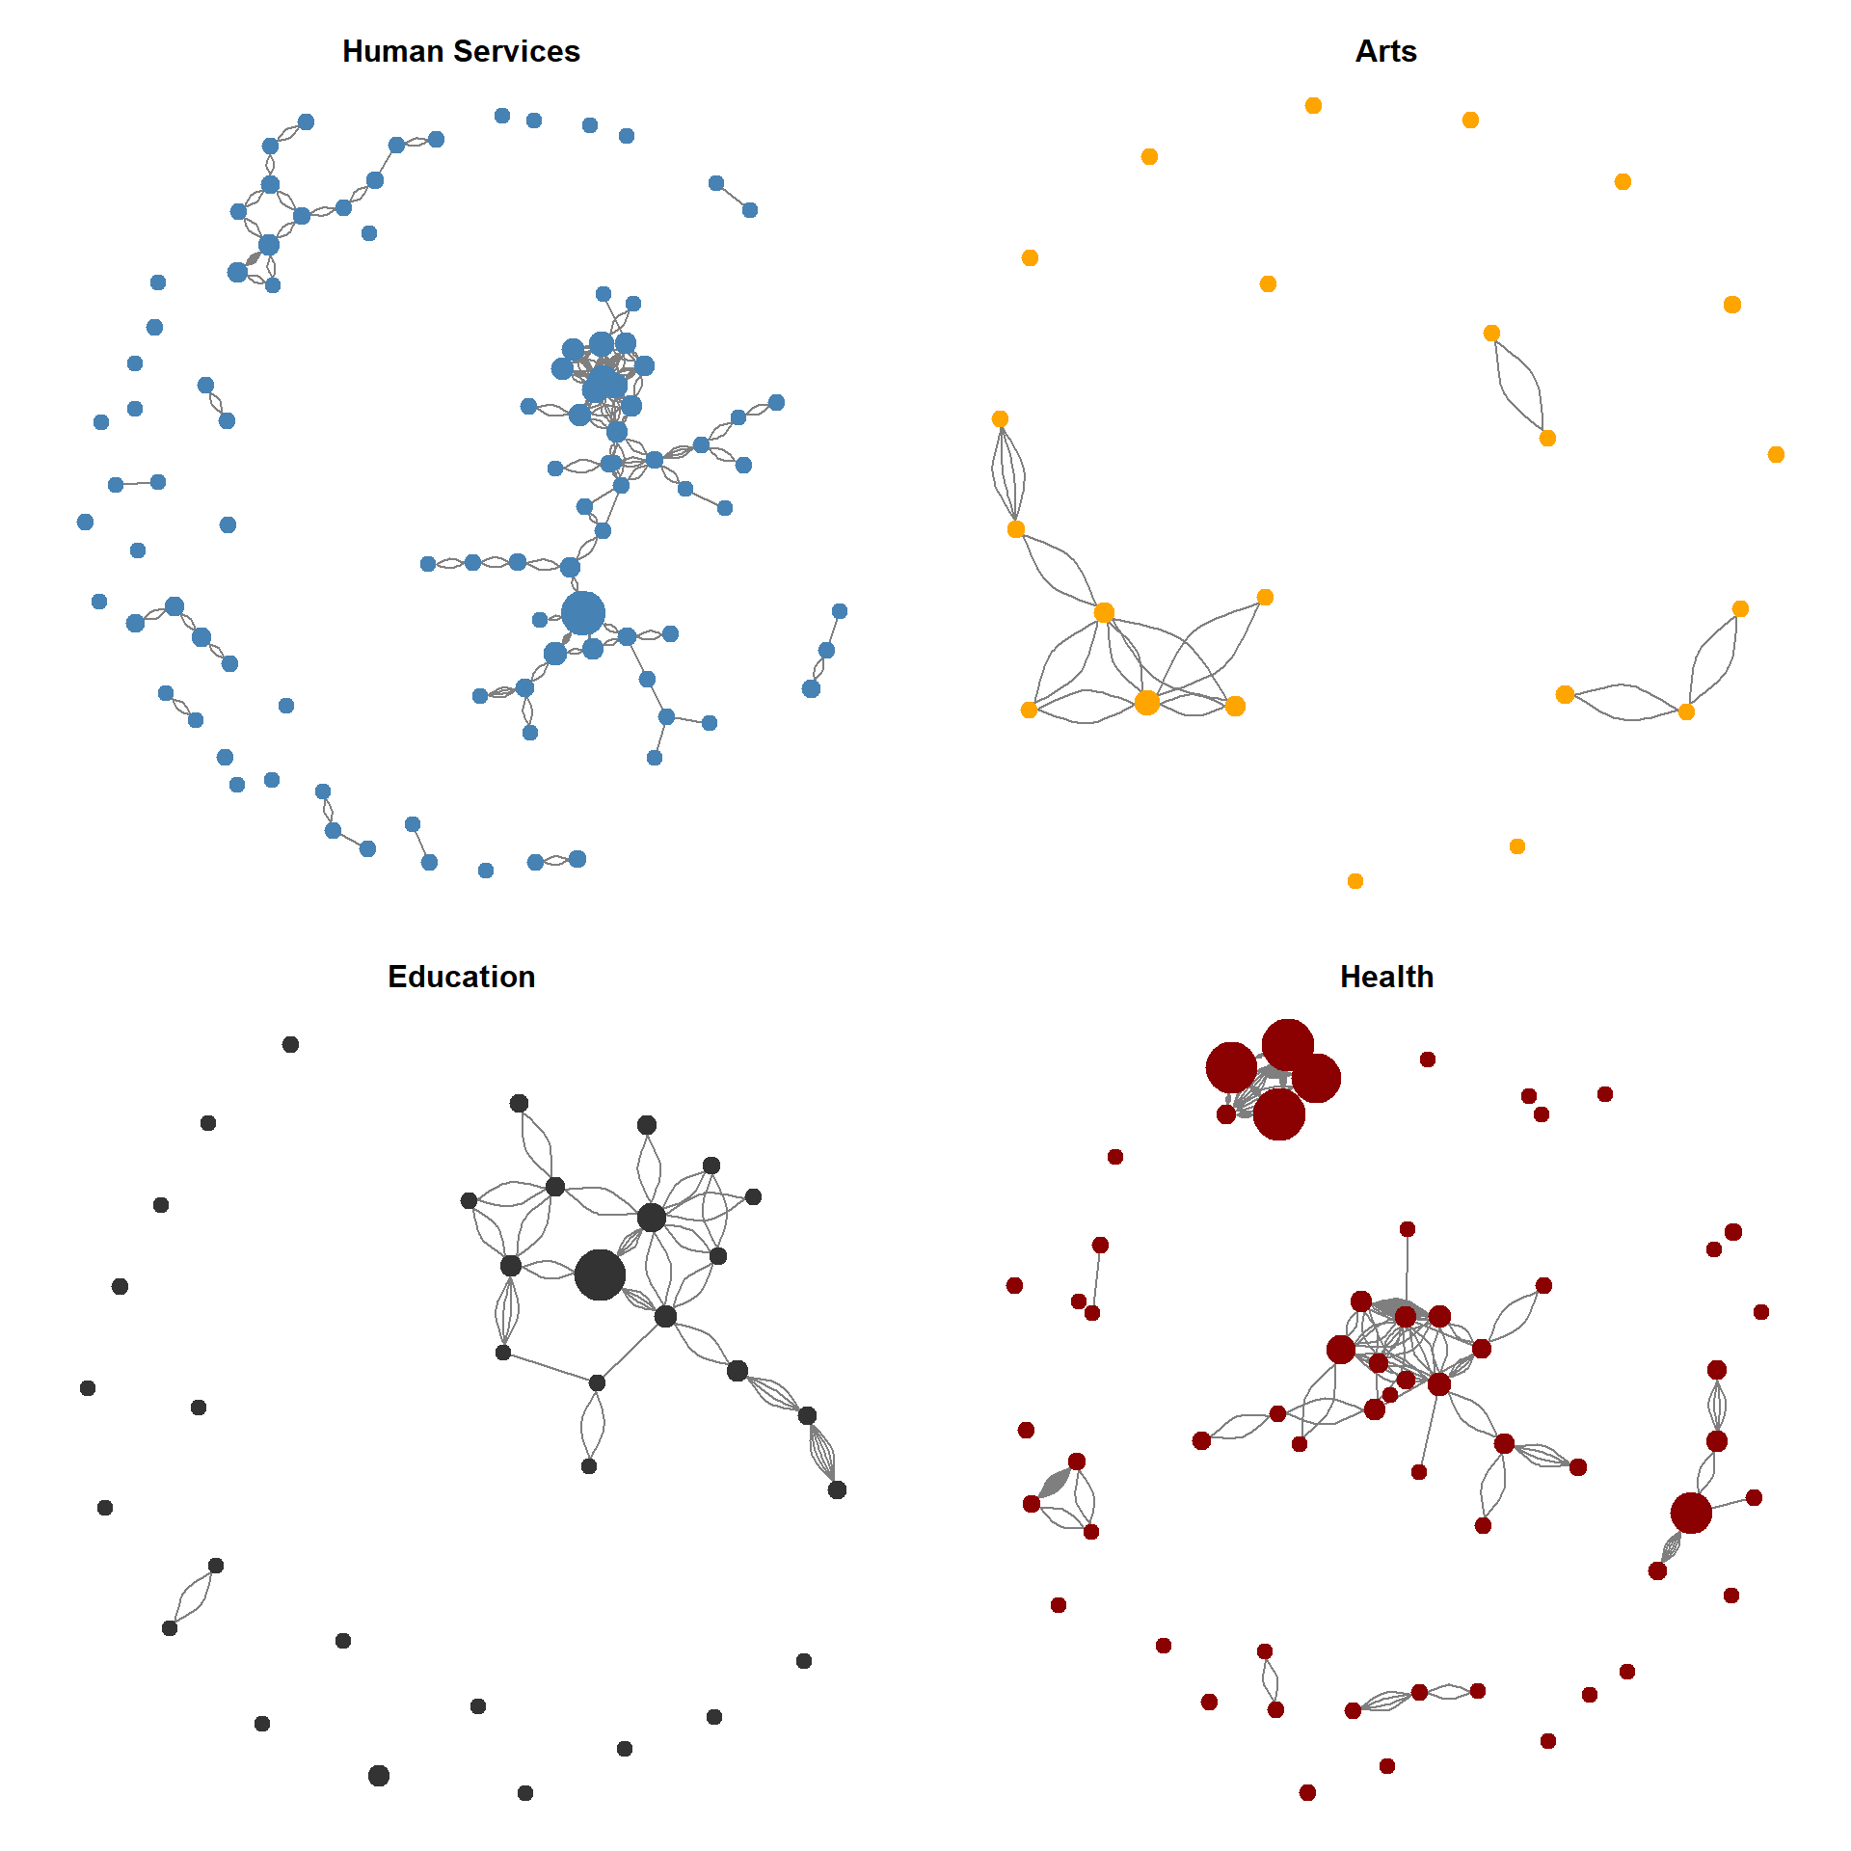

Slide 24
Moving Forward

Slide 25
Master Plan:
(Nonprofit Open Data Collective)
Master Concordance File
Build Scripts
Documentation
Data tables
Data dictionary
(Blueprints)
(Datasets)

Slide 26
Additional open data assets for the nonprofit sector:
IRS E-Filer Database: All nonprofit 990 data that is filed electronically, about 60% of nonprofits.
Index of all E-Filers from 2009 to Present: A list of all organizations that have electronically filed each year.
Current Exempt Organizations: The current list of all tax-exempt organizations.
IRS Business Master File: Organizational characteristics of all current exempt organizations.
990N Postcard Filers: Data on nonprofits that are small enough to file the abbreviated “postcard” version of the 990 form.
IRS Automatic Revocations:” Database of nonprofits that had their tax exempt status revoked for failing to file.
Organizations Granted Tax Exempt Status through 1023-EZ Form: Data filed electronically on the new shorter 1023-EZ application for 501(c) status.

Slide 27
Development and Cleaning

Slide 28
Master Concordance File: Grouping Xpaths by a Common Variable

Slide 29
VARIABLE XPATHS
F9_01_PZ_PROGSERREVCY | /Return/ReturnData/IRS990/CYProgramServiceRevenueAmt
F9_01_PZ_PROGSERREVCY | /Return/ReturnData/IRS990/ProgramServiceRevenueCY
F9_01_PZ_PROGSERREVCY | /Return/ReturnData/IRS990EZ/ProgramServiceRevenue
F9_01_PZ_PROGSERREVCY | /Return/ReturnData/IRS990EZ/ProgramServiceRevenueAmt

Slide 30
What does Valid Mean?
Program Service Revenue
 | /Return/ReturnData/IRS990/CYProgramServiceRevenueAmt
 | /Return/ReturnData/IRS990/ProgramServiceRevenueCY
 | /Return/ReturnData/IRS990EZ/ProgramServiceRevenue
 | /Return/ReturnData/IRS990EZ/ProgramServiceRevenueAmt

Slide 31
Problem 1: Deviant Xpaths
Program Service Revenue
 | /Return/ReturnData/IRS990/CYProgramServiceRevenueAmt
 | /Return/ReturnData/IRS990/ProgramServiceRevenueCY
 | /Return/ReturnData/IRS990EZ/ProgramExpenses
 | /Return/ReturnData/IRS990EZ/ProgramServiceRevenueAmt

Slide 32
Problem 2: Merger Needed
Program Service Revenue CY
 | /Return/ReturnData/IRS990/CYProgramServiceRevenueAmt
 | /Return/ReturnData/IRS990/ProgramServiceRevenueCY
 | /Return/ReturnData/IRS990EZ/ProgramServiceRevenue
 | /Return/ReturnData/IRS990EZ/ProgramServiceRevenueAmt
Program Service Revenue

Slide 33
How do we check this?

Slide 34
SUMMARY REPORTS FOR NUMERIC VARIABLES
http://cn-validatathon.s3-website-us-east-1.amazonaws.com/reports/F9_01_PC_TOTEXPSCY.html
SUMMARY REPORTS FOR TEXT VARIABLES
http://cn-validatathon.s3-website-us-east-1.amazonaws.com/reports/F9_00_PC_PRINCIPALFORCTRY.html

Slide 35
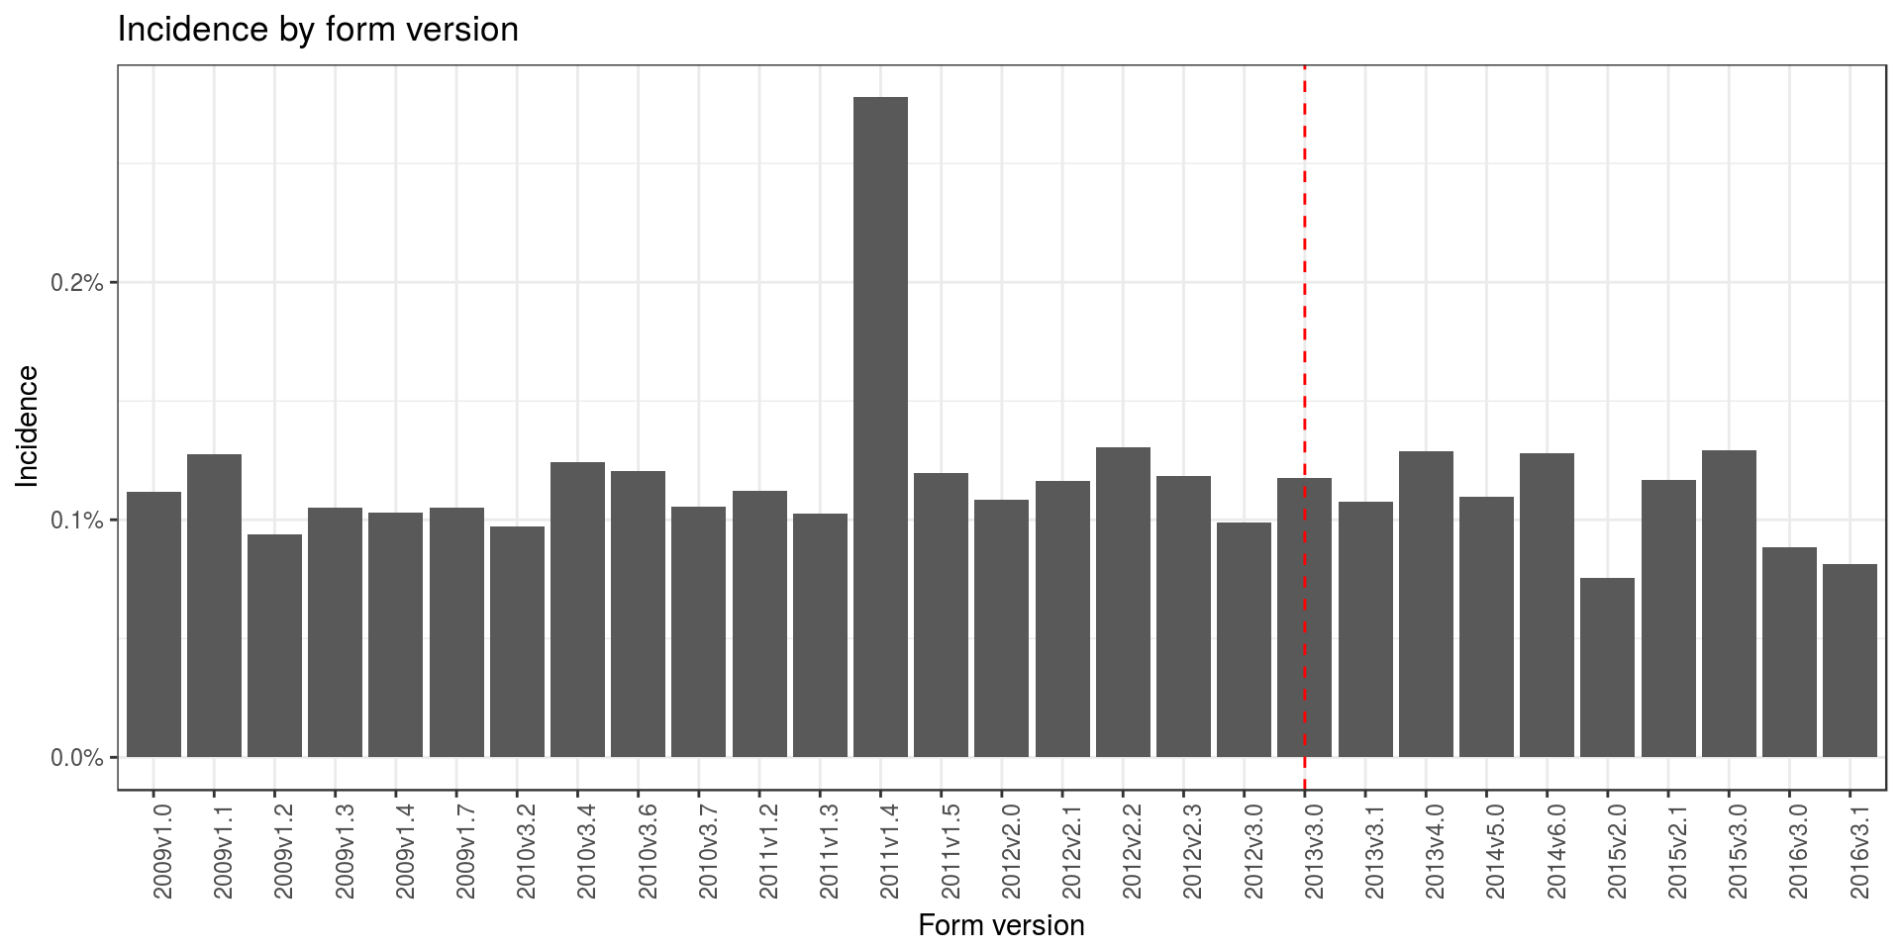
Good Sign

Slide 36
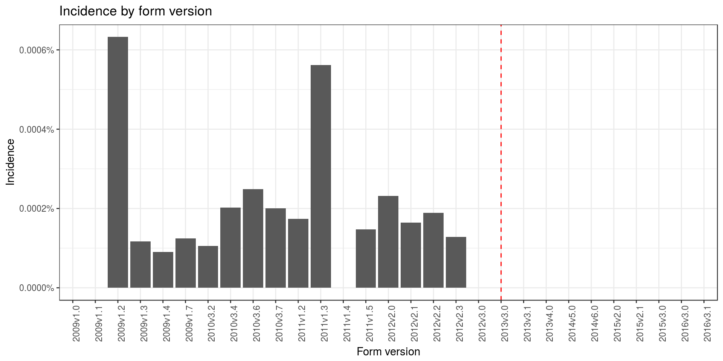
Bad Sign
Note Pre-Post 2013 Changes

Slide 37
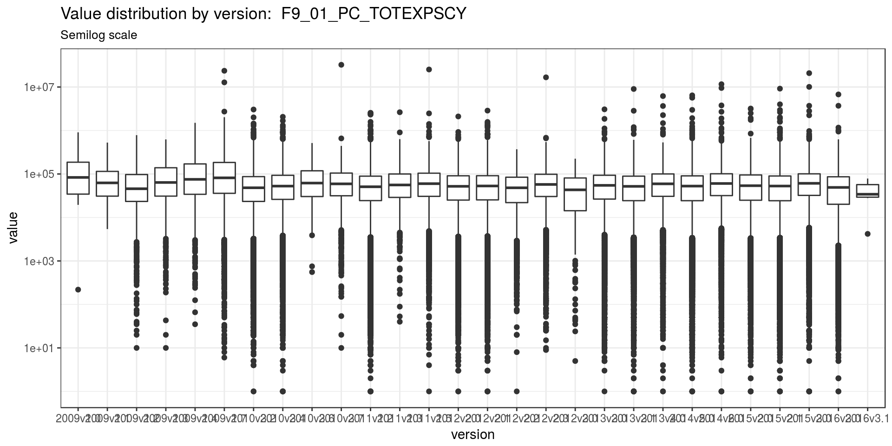
Good Sign

Slide 38
Step 3: Update Metadata in the Master Concordance File

Slide 39
Variable “Descriptions”

Slide 40
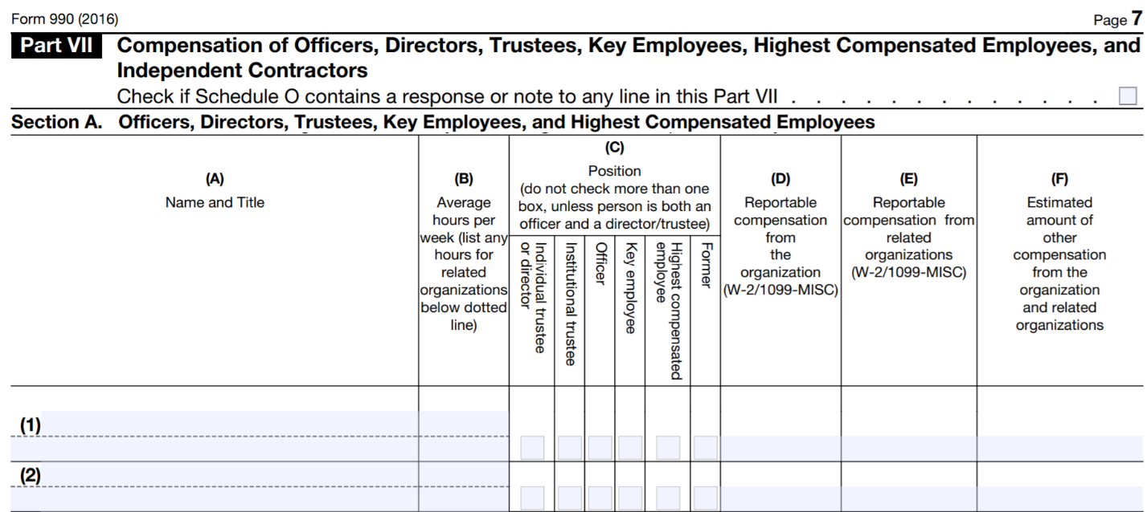
Variable “Descriptions”
Change to: “Name and title of officers, directors, trustees and key employees”

Slide 41
Location Codes:
The location code indicates where the fields are located on the Form 990 or Schedule. These are included in the data dictionary so that the user can reference the original form if necessary.
FORM 990
F990-PC-PART-03-LINE-01 F990-EZ-PART-11-LINE-04C F990-PC-PART-03-SECTION-A-LINE-09 F990-EZ-PART-11-SECTION-B-LINE-04A F990-EZ-PART-11-SECTION-B-LINE-08-COL-A SCHEDULES SCHED-A-PART-03-LINE-12B SCHED-B-PART-02-SECTION-B-LINE-04

Slide 42
Location Codes:
Use the following conventions for location codes – this will ensure that they are machine-readable and can be easily searched.
Specify the relevant Form or Schedule using “F990-PC”, “F990-EZ”, or “SCHED-X”.
Specify the location on the form using PART-##. Use 01, 02, up to 09 for numbers less than 10.
Use PART-00 (zero-zero) for any variables that occur in headers or footers, not numbered sections.
If the form part is split into sections, include as SECTION-X.
If a line exists, record as LINE-01 or LINE-01A.
If columns exists, match column names using COL-A, COL-B, etc.
Include enough info to ensure the location code is unique.
In a couple of instances you may need to create section codes, even though they are not explicit on the forms but line numbers reset within a form Part.

Slide 44
Why Open Science
Errors in Scientific Research
Rogath and Reinhardt, Levitt
Crisis of reproducibility
P-value hacking
“We had a big party, they have to clean up the mess”
Building Blocks
How many solutions to hard problems are sitting in do files on laptops?
Repurpose data, repurpose code

Slide 45
Right Time for Open Science
Software
Data
Availability is no longer the problem, linking data is challenge
Crisis of reproducibility

Slide 46
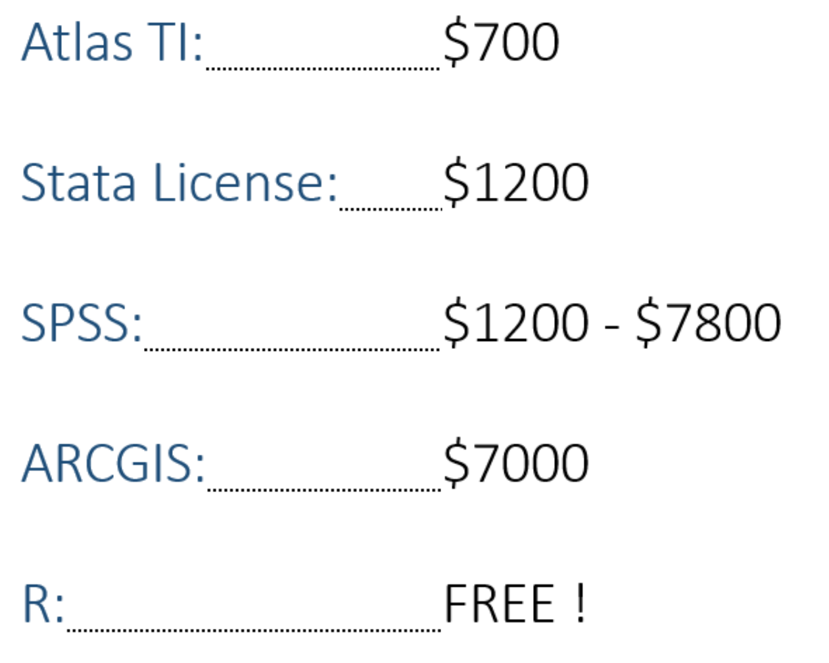

Slide 47
Data-driven documents markdown
Reports [ html ] [ pdf ]
Books [ link ]
Presentations [ link ]
Tutorial [ link ]
Websites [ link ]
Dashboards [ link ]
Web Apps [ link ] [ link ] [ CDC ]

Slide 48
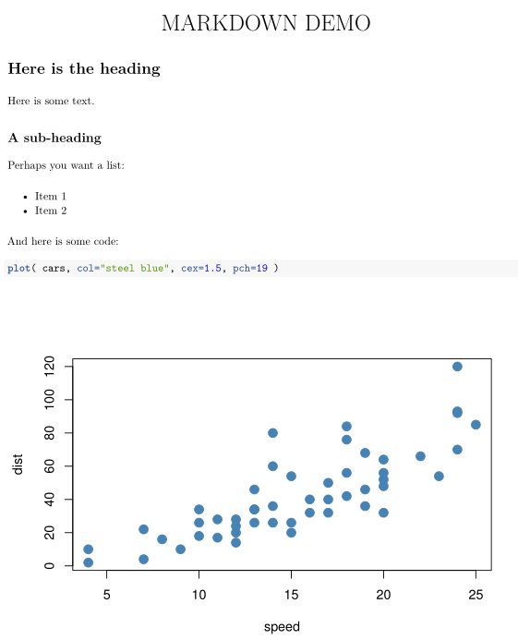
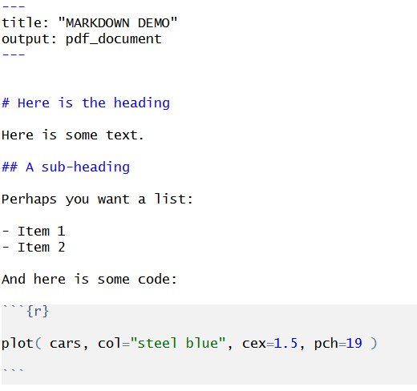
render

Slide 49
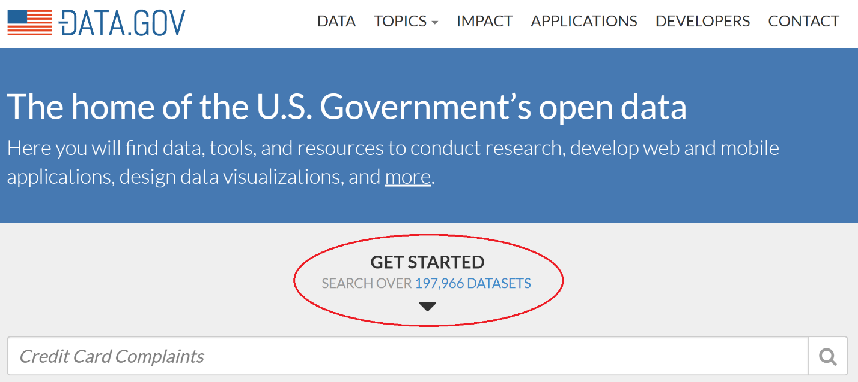
Open Government Data Explosion
197,966 DATASETS !!!

